Slide 1
Resolution Predicate
Guia Alex
Group 913

Slide 2
Exercise 3.3
Prove the inconsistency of the following set of clauses using lock resolution.​ Try two different indexing for the literals.​
S={ P(x) V Q(x) V R(x) , -P(a) , -Q(x) , -W(a) , -R(y) V W(y) }

Slide 3
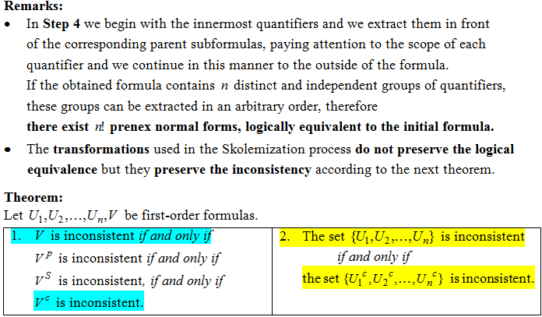
Remarks and Theorem

Slide 4
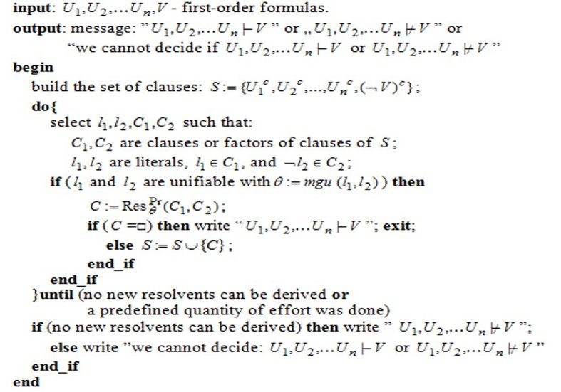
The Algorithm for Predicate Resolution​

Slide 5
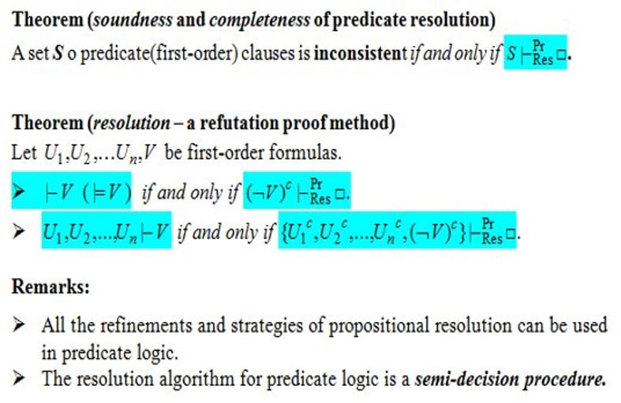
Theoretical Result

Slide 6
First Solution
S={ P(x) V Q(x) V R(x) , -P(a) , -Q(x) , -W(a) , -R(y) V W(y) }
The literals are indexed as follows​
C1= (1)P(x) ∨ (2)Q(x)​ V (3)R(x)
C2= (4) -P(a)​
C3=(5) ¬ Q(x)
C4= (6)¬W(a)​
C5=(8) -R(y) ∨ (7)W(y)

Slide 7
First Solution
S={ P(x) V Q(x) V R(x) , -P(a) , -Q(x) , -W(a) , -R(y) V W(y) }
The following resolvents are obtained:​
C6 = ResPr01= [x<-a](C1,C2) = (2)Q(a)​ V (3) R(a)
C7 = ResPr 02= [x<-a](C6,C3) =(3) R(a)​
C8 = ResPr03 = [y<-a](C4,C5) = (5)¬R(a)​
C9 = ResPr = (C7,C8) = □​
​
=>S|-locr Pr Res □ is inconsistent​

Slide 8
Second Solution
S={ P(x) V Q(x) V R(x) , -P(a) , -Q(x) , -W(a) , -R(y) V W(y) }
The literals are indexed as follows​
C1= (1)P(x) ∨ (2)Q(x)​ V (3)R(x)
C2= (4) -P(a)​
C3=(5) ¬ Q(x)
C4= (6)¬W(a)​
C5=(8) -R(y) ∨ (7)W(y)

Slide 9
Second Solution
S={ P(x) V Q(x) V R(x) , -P(a) , -Q(x) , -W(a) , -R(y) V W(y) }
The following resolvents are obtained:​
C6 = ResPr01= [x<-a](C1,C3) = (2)P(a)​ V (3) R(a)
C7 = ResPr 02= [x<-a](C6,C2) =(3) R(a)​
C8 = ResPr03 = [y<-a](C5,C4) = (5)¬R(a)​
C9 = ResPr = (C8,C7) = □​
=>S|-locr Pr Res □ is inconsistent​

